Slide 1
Assignment: GDP Analysis

Slide 2
GDP Analysis of Indian States
Average growth of states over the duration 2013-16
Andhra Pradesh 12.632500
Arunachal Pradesh 14.162500
Assam 11.877500
Bihar 13.765000
Chhattisgarh 13.352500
Goa 2.020000
Gujarat 12.767500
Haryana 13.042500
Himachal Pradesh 12.816667
Jammu & Kashmir 11.002500
Jharkhand 12.567500
Karnataka 14.230000
Kerala 12.752500
Madhya Pradesh 14.647500
Maharashtra 12.103333
Manipur 11.890000
Meghalaya 7.667500
Mizoram 16.866667
Nagaland 15.953333
Odisha 10.712500
Punjab 11.346667
Rajasthan 11.940000
Sikkim 10.492500
Tamil Nadu 12.712500
Telangana 12.497500
Tripura 15.613333
Uttar Pradesh 12.367500
Uttarakhand 12.382500

Slide 3
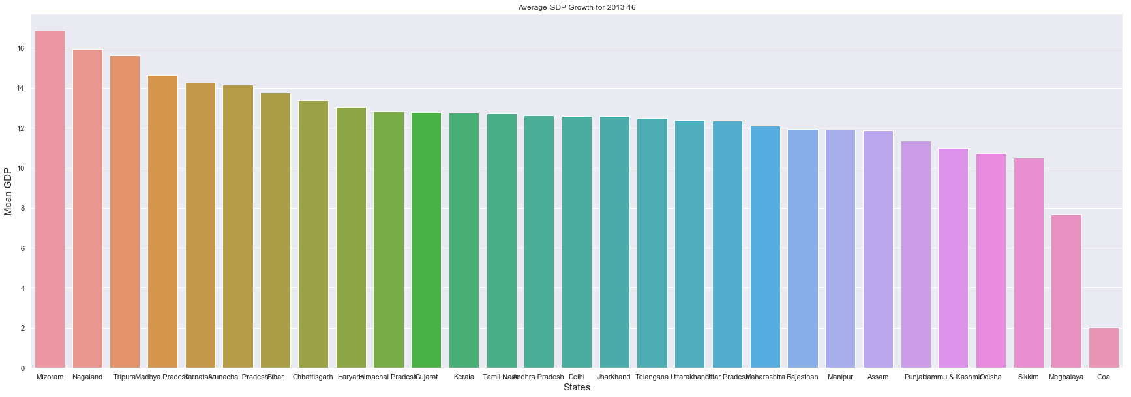
State wise analysis

Slide 4
Fast growing states
Mizoram
Nagaland
Tripura
Madhya Pradesh
Karnataka

Slide 5
Stagnant States
J & K
Odisha
Sikkim
Meghalaya
Goa

Slide 6
Average Growth Rate of Himachal
12.81%
Is almost equal to the mean of the country

Slide 7
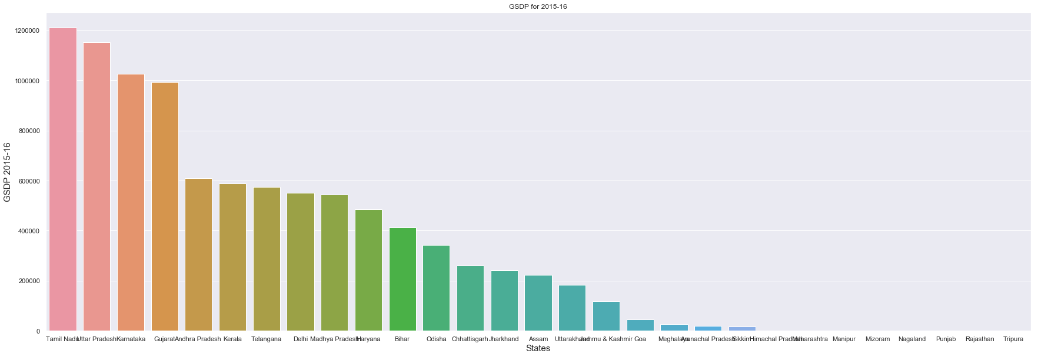
GDP of the states for the year 2015-16

Slide 8
Analysis on total GDP year 2015-16
Top 5 States:
Tamil Nadu
Uttar Pradesh
Karnataka
Gujarat
Andhra Pradesh

Slide 9
Analysis on Total GDP Year 2015-16
Bottom 5 states:
Sikkim
Arunachal Pradesh
Meghalaya
Goa
J&K

Slide 10
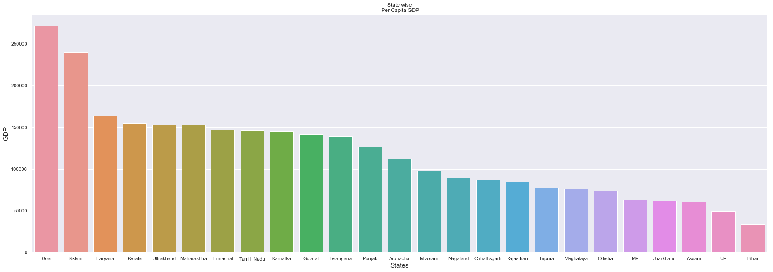
GDP per capita for all states

Slide 11
GDP per capita for all the states
Top 5 states:
Goa
Sikkim
Haryana
Kerala
Uttrakhand

Slide 12
GDP per capita for all the states
Bottom 5 states:
Bihar
Uttar Pradesh
Assam
Jharkhand
Madhya Pradesh

Slide 13
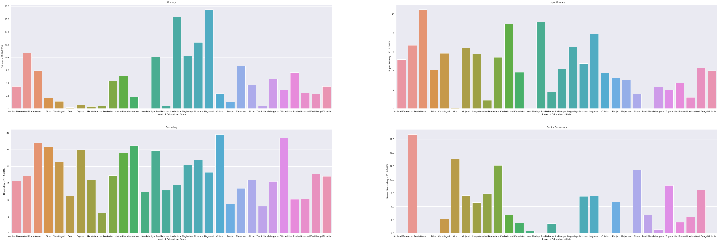
GDP and Education Drop-out Rates

Slide 14
Observation
It is observed that the states with a lower drop out rate in primary and upper primary have a better overall GDP and the sector for their growth is tertiary.

